Slide 1
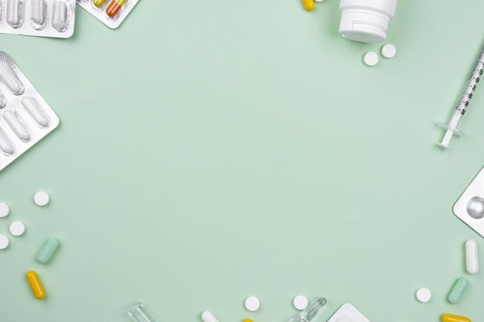
Pharmacy Medicine Supply Management System Cohort : INTCDE22IJ046 (POD 1)

Slide 2
Our Special thanks
MENTOR | K, Manikandan
TRAINER | Krishna Kumar Maddela, Venkata
COACH | R, Prema

Slide 3
Team Members
NAME | EMP ID
SHASHWAT CHATURVEDI | 2150203
ANUSHKA PRIYA | 2147784
AJAY KHARAT | 2148888
SATYAJIT DEBNATH | 2152784
SATAKSHI SINGH | 2147207

Slide 4
A Pharmaceutical company wants to automate the logic of forming a schedule for their medical representatives to meet the targeted doctors to explain their medicines and its nature for prescription. Based on the response from doctors, the medicine demand will be determined. This should be fed into the system to determine the medicine supply detail to its Pharmacists. The application developed will target this requirement.
PROBLEM STATEMENT

Slide 5
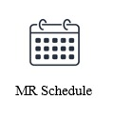
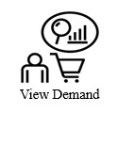
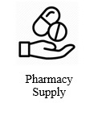
FEATURES

Slide 6
FEATURES
The intent of these features is to provide a doctor meet schedule for the Representatives of the company:
MR Schedule
Schedule
Doctor’s Appointment
Pharmacy Supply
Place Order
List of Orders
Check and Update Stock
View Demand
List of Medicines Demanded
SignIn and SignUp
Authenticated User Login
Register User

Slide 7
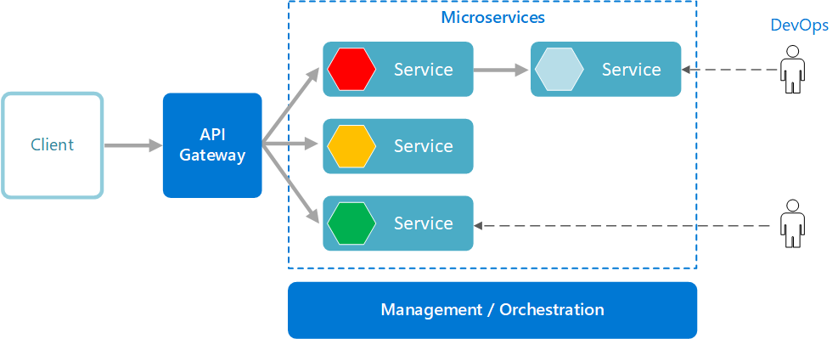

SYSTEM ARCHITECTURE

Slide 8
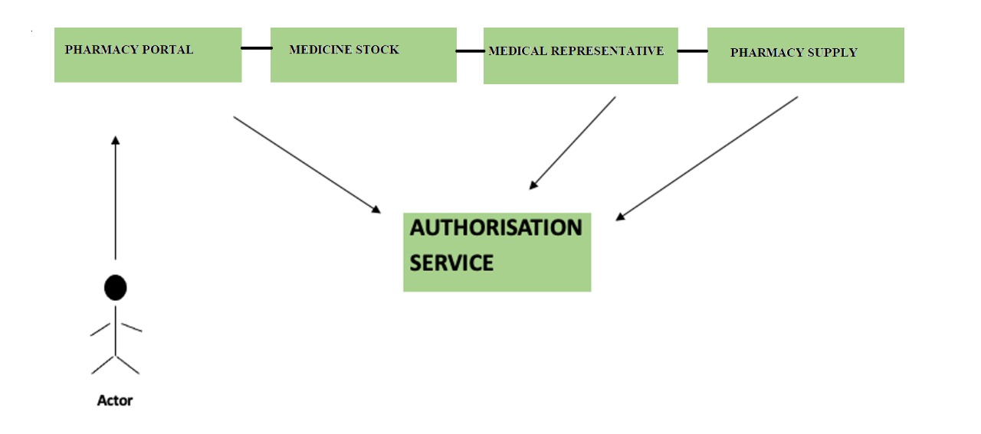
USE CASE DIAGRAM

Slide 9
List of Technologies
Spring Rest
Spring JPA
Lombok
Postman
Feign client
Logging
Angular
Junit
AWS
H2 Database

Slide 10
List of Microservices
1. Authorization
Microservice
2. Medicine Stock
Microservice
3. Medical Representative
Microservice
4. Pharmacy Supply
Microservice

Slide 11
Authorization Microservice
JWT (JSON Web Token) is used for authorization. The tokens contain claims that are encoded as a JSON object and are digitally. They are self-contained and verifiable as they are digitally signed. JWT’s can be signed and/or encrypted.
JWT’s can also be used for the exchange of information though they more commonly used for authorization as they offer a lot of advantages over session management using in-memory random tokens.
A JWT token is divided into 3 parts namely – header, payload, and signature.
The token is usually generated in the server and sent to the client where it is stored in the session storage or local storage.

Slide 12
Authorization Microservice
Implementation:
Modify default spring security for UserDetailsService to get our users from database during login.
Create JwtUtil class to generate and validate tokens.
Create one endpoint to authenticate using AuthenticationManager and to generate token using JwtUtil. This endpoint will take user details and generate token.
Modify default spring security to allow all request at above endpoint without authentication.
During each request, Intercept the request and extract the token from request header and validate it. This can be done using filter. Do not maintain the state as JWT is stateless authentication method.
Endpoints:
GET: /validate – to validate token
POST: /signin – to authenticate and generate token using user.
POST: /signup – to register and save user details in database.
GET: /user-details – to fetch all users from DB for MR-scheduler

Slide 13
Medicine Stock Microservice
This microservice provides information on the details of the medicines like the medicine name, chemical composition, date of expiry, number of tablets target ailment
It provides details of medicine stock available in the company after all supply.
Endpoints:
GET: /medicine/stock – to get the available medicine stock from DB
GET: /medicineByAilment/{targetAilment} – to get medicine by ailment from DB. It is used for mapping with doctors. (It is accessed from MR Microservice).
POST: /updateStock – to update stock by substracting supply count and save in DB. (It is accessed from Pharmacy Supply Microservice).
Database:
Medicine Stock DB,
User Details (Served as MR).

Slide 14
Medical-Representative Microservice
It creates a schedule to have meetings with doctors. The list of doctors that this pharma company is targeting can be stored as a pre-defined information in this Microservice. (CSV file)
This module should interact with the medicine stock module to find the medicine stock to be explained to the targeted doctors.
Post Authorization using JWT, based on pre-defined doctor information, the microservice should map the available representatives for a period of 5 days. The start date of the schedule should be sent as input from the web portal. Sunday shouldn’t be considered for reps meeting.
Endpoints:
GET: /RepSchedule/{scheduleStartDate} – to get the schedule.

Slide 15
Medical-Representative Microservice
Functionalities:
Doctors List – doctors details are stored in CSV file. It can be parse into java object using java file handling. (BufferReader, InputStream, readLine).
MR List – medical representative can be accessed from User DB using rest call to Authorization microservice. (Feign Client)
Medicine By Ailment – to get medicine according to doctor’s ailment. Medicine can be accessed from Medicine Stock DB using rest call to Medicine Stock microservice. (Feign Client)
MR schedule – Get doctor from csv and get MR from user DB.
If start date is before today, the return empty schedule.
If start date is of today but time after 1 PM, then update start date by plus 1 day.
Loop through doctors list (By incrementing date) – if week day is Sunday, then add plus 1 day. Map MR and Doctor for appointment and return the schedule.

Slide 16
Pharmacy Supply Microservice
This microservice should be invoked from the Web portal. It allows the following operations:
Maintains the list of pharmacies that the company does business with.
Receives input from the web portal for the medicine count needed. Upon receiving this, this microservice should interact with Medicine Stock service to get the current stock.
This count should be split equally among all the pharmacists and the list should be returned to the web portal. If the stock count is lesser than the demand, then the stock count should be considered.
Endpoints:
POST: /pharmacy-supply – It takes demand as input and give the list of pharmacy supply. Also save it in DB.
GET: /viewDemand – to get medicine demand list with date of demand from DB.
GET: /pharmacy-medicine-supply – to get pharmacy supply list from DB

Slide 17
Pharmacy Supply Microservice
Database:
Medicine demand DB
Pharmacist DB
Pharmacy supply DB
Functionalities:
Medicine stock – to get how many number of demanded medicines are available in the stock. We have made a rest call to Medicine Stock microservice. (Feign Client)
Update stock – to update the stock by substracting medicine supply from available stock. We have made a rest call to Medicine Stock microservice. (Feign Client)
Pharmacy Supply List – Get medicine demand from portal and get pharmacist list from DB.
Get the available stock by rest call to medicine stock microservice.

Slide 18
Pharmacy Supply Microservice
If demand count is more than stock count then, supply count will be stock count. Else it will be same as demand count.
Loop through pharmacist list (By decrementing supply count) – divide supply count equally between all pharmacists using mathematical logic. Return the list of pharmacy supply.
Save the list into database. Both demanded medicine and supply list will be saved in Database.

Slide 19

Challenges Faced
Connecting the frontend with microservices was complex.
Large number of microservices places an overhead to keep track of them when the service is down.
Up-front costs may be higher with microservices.
Debugging becomes more challenging with microservices.
Traffic/Permission issues faced while deploying microservices on AWS.

Slide 20
POSTMAN
Rest Call

Slide 21
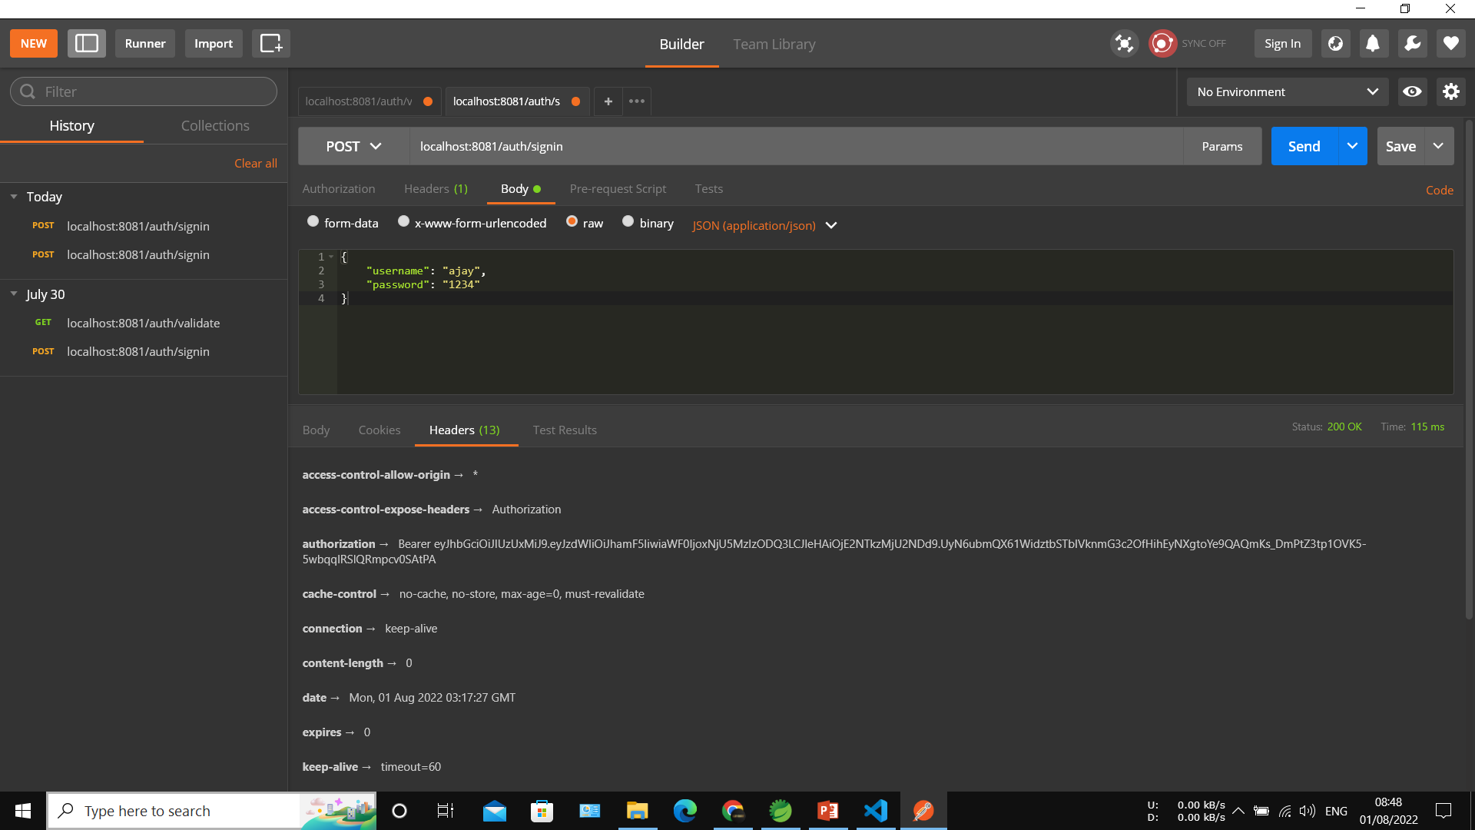

Slide 22
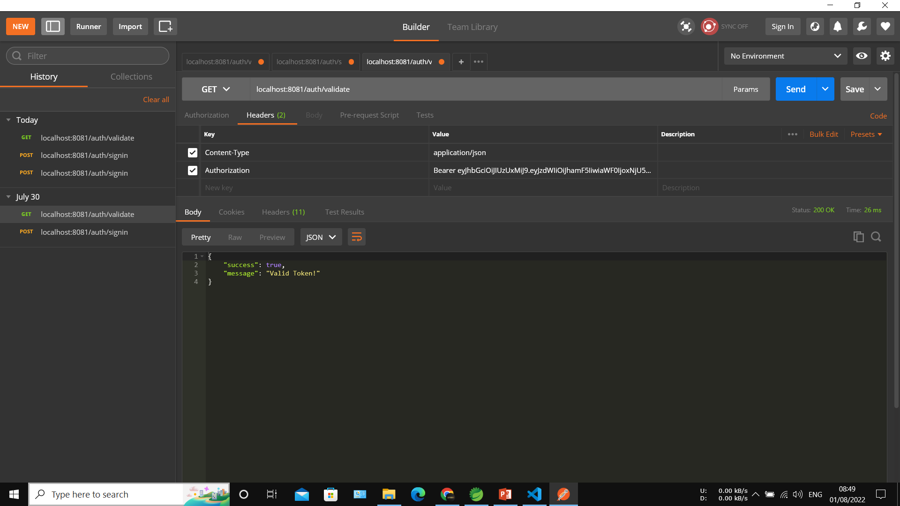

Slide 23
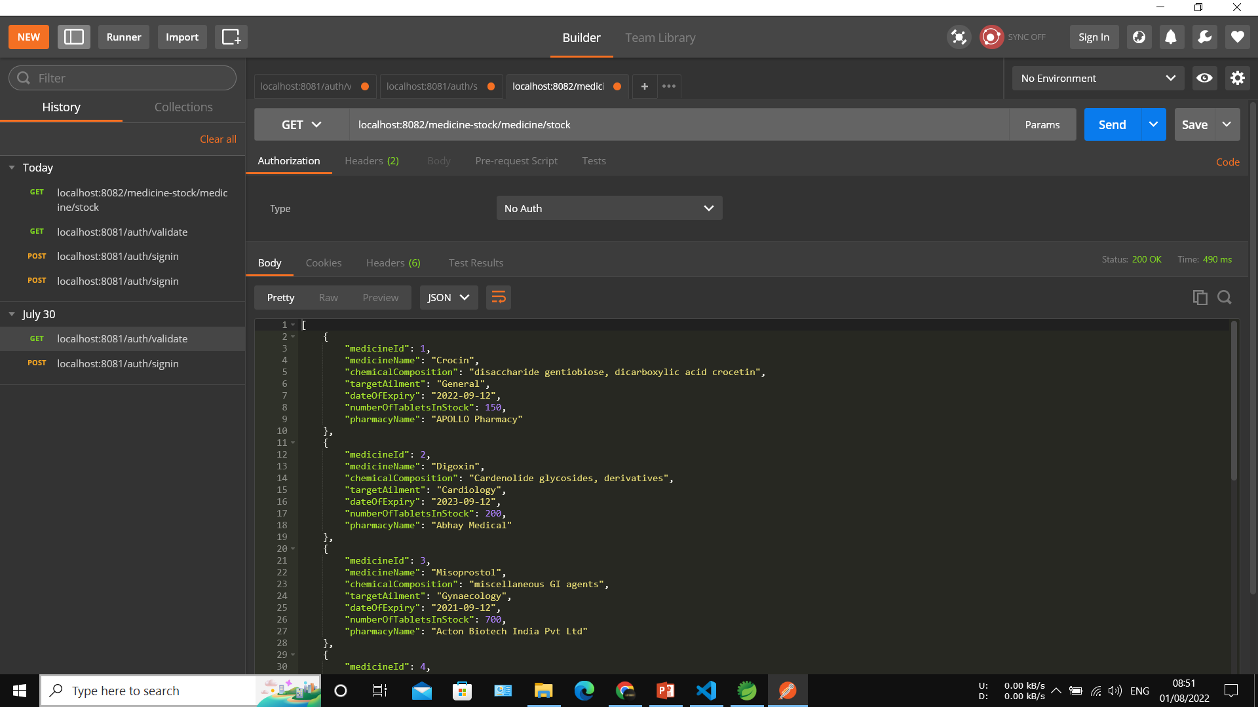

Slide 24
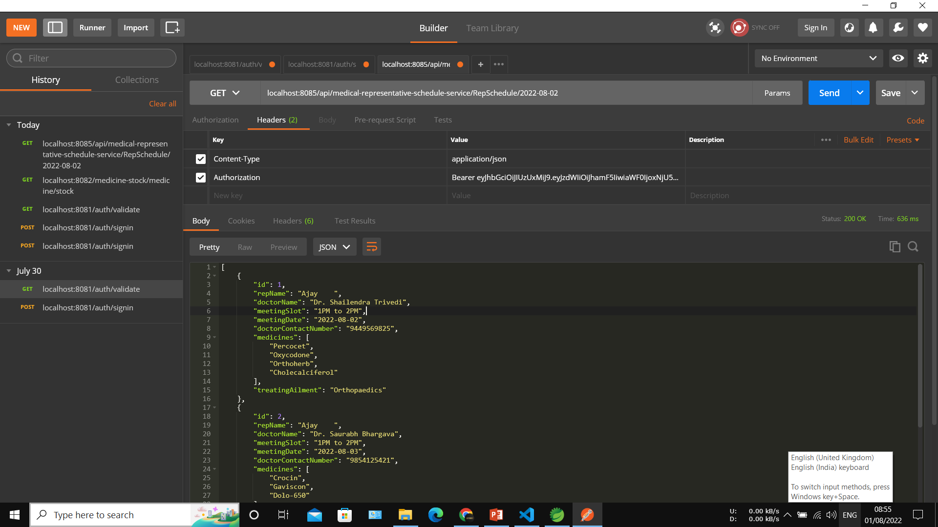

Slide 25
DATABASE
H2 Database Engine

Slide 26
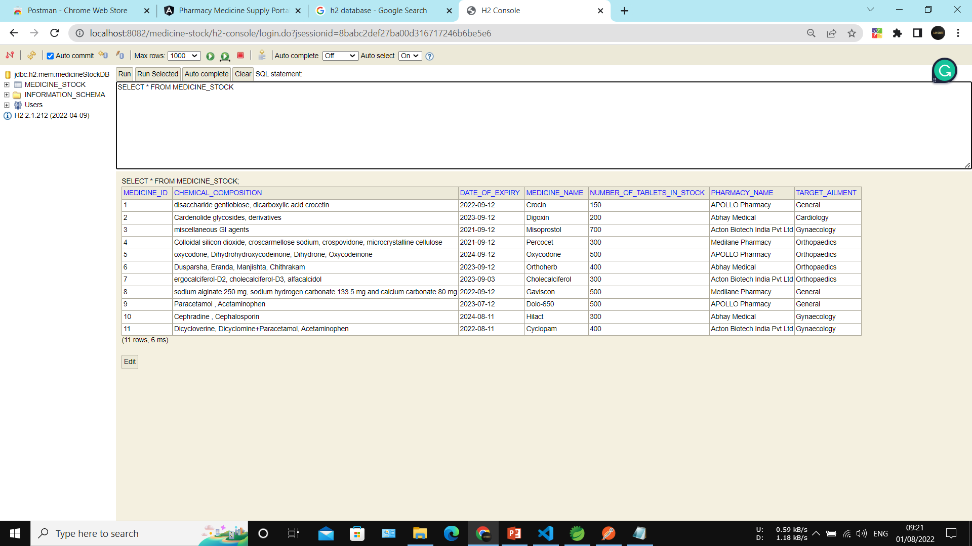

Slide 27
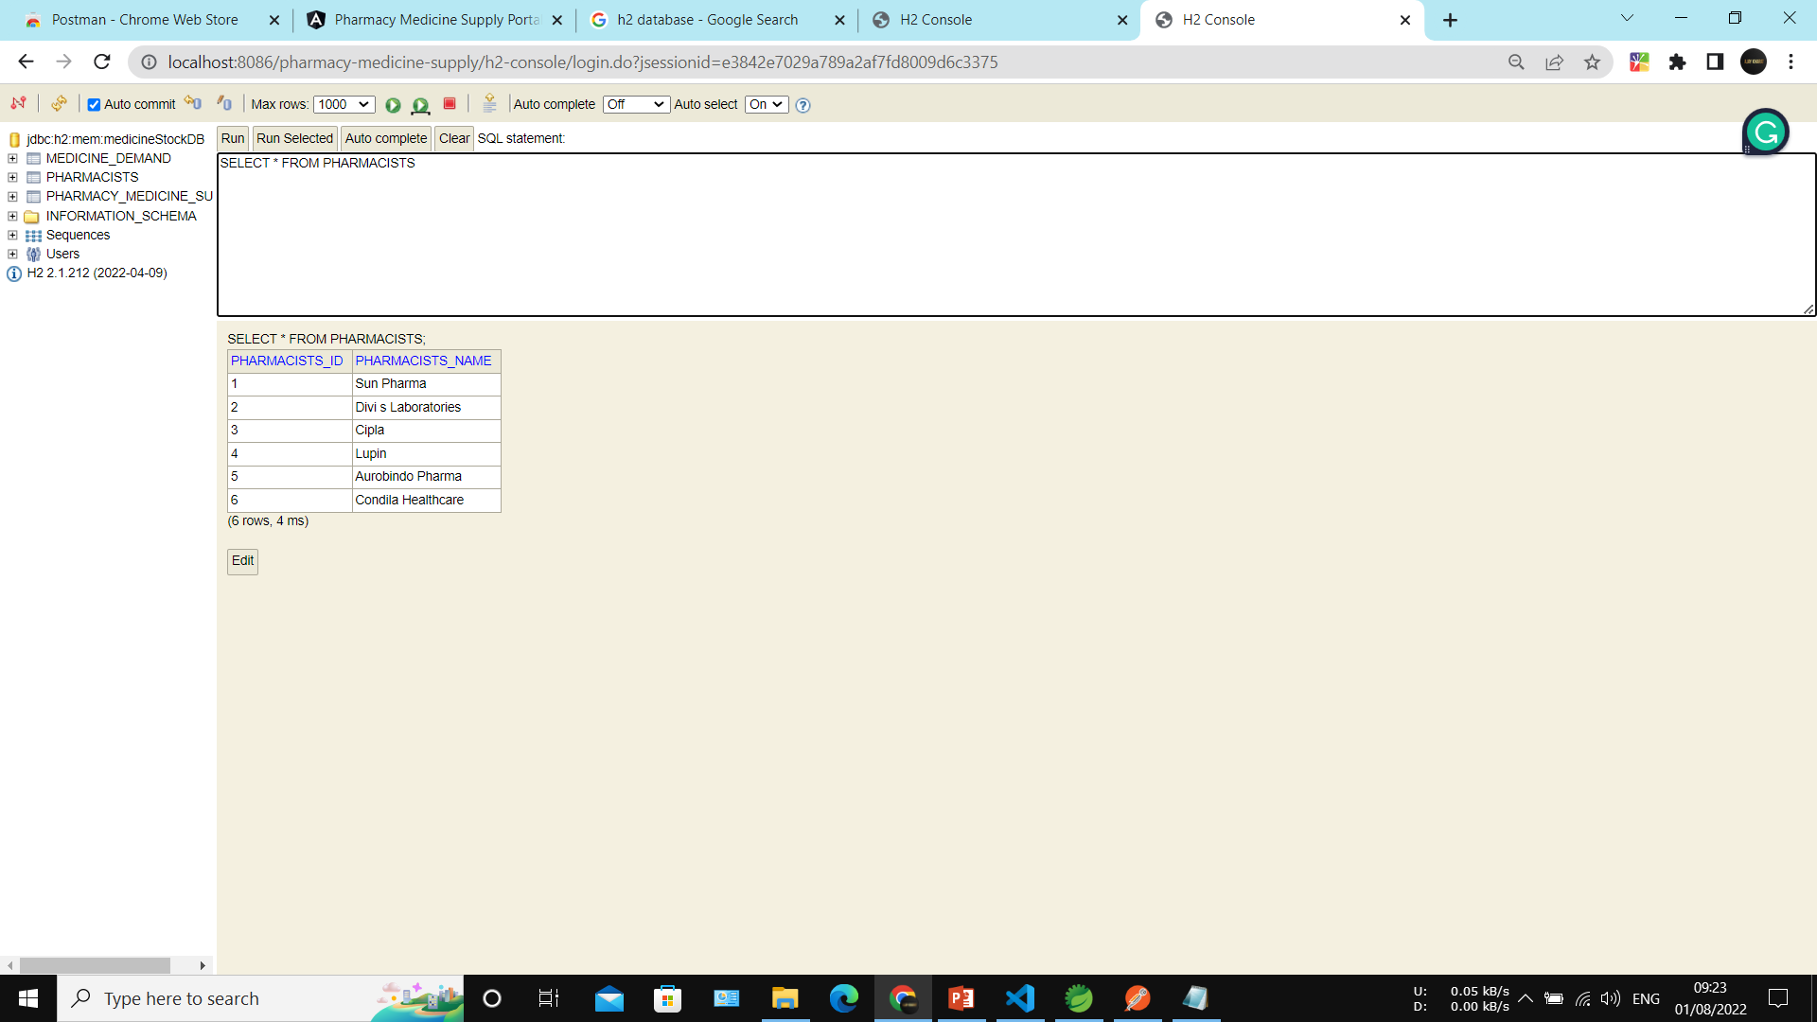

Slide 28
TESTING
JUnit & Mockito

Slide 29
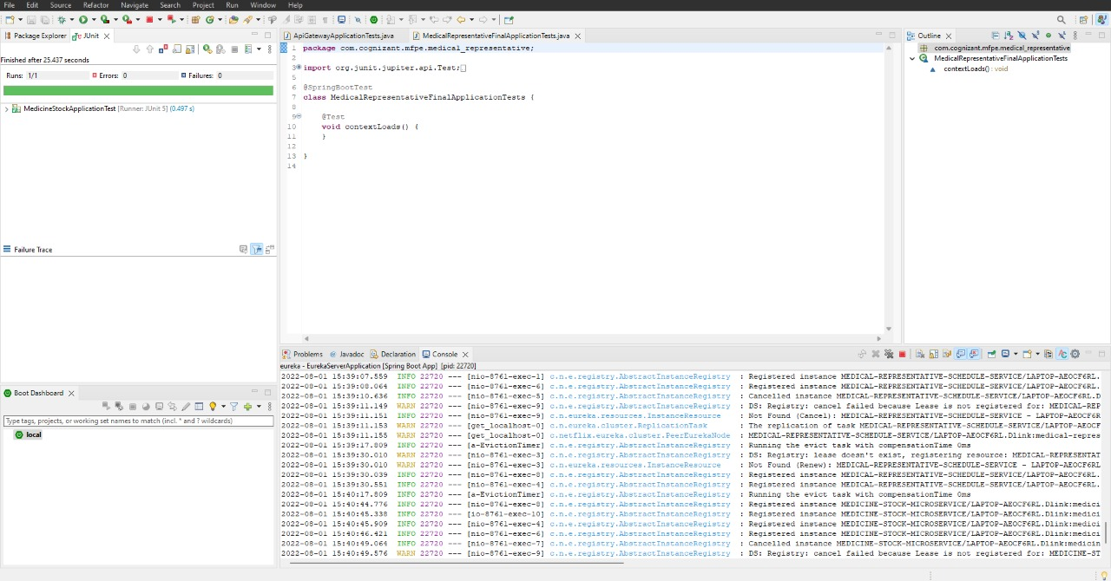
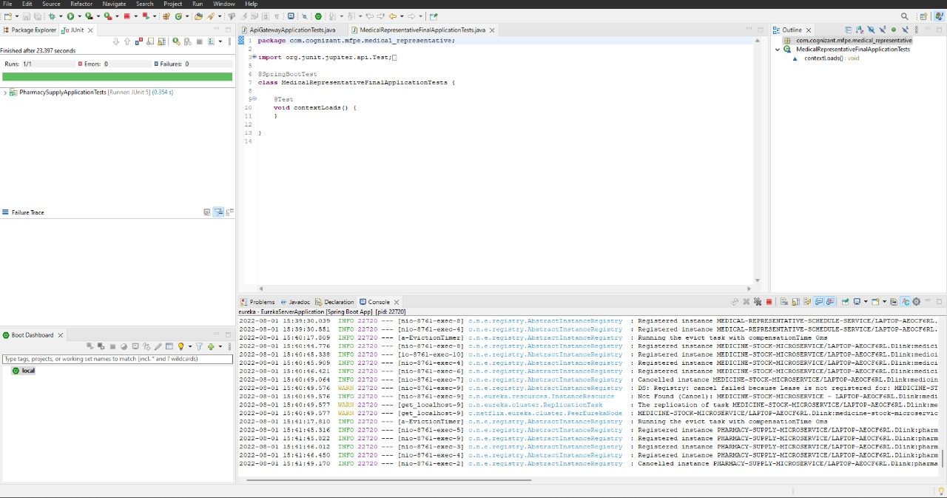
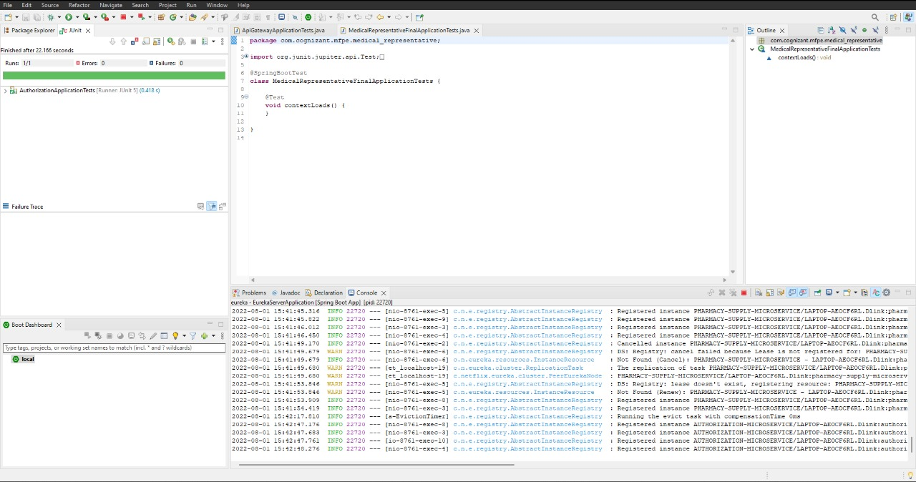
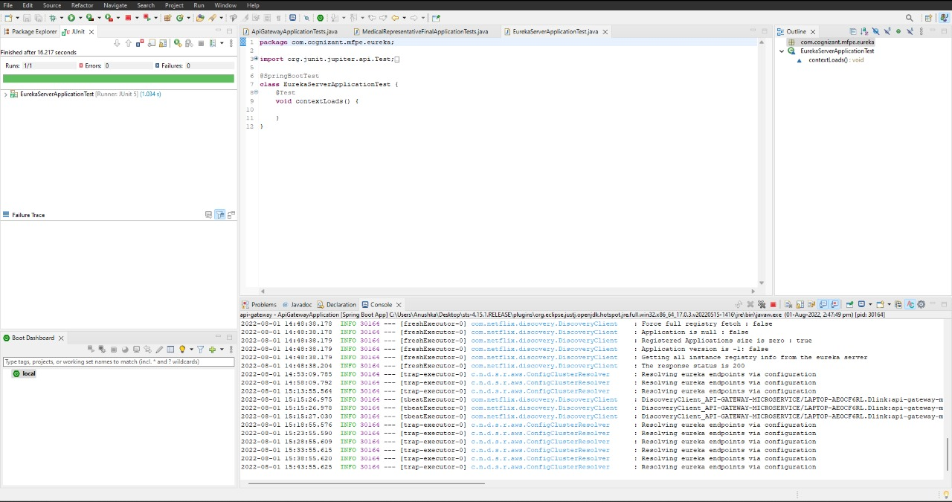

Slide 30
EUREKA SERVER
Service Discovery

Slide 31
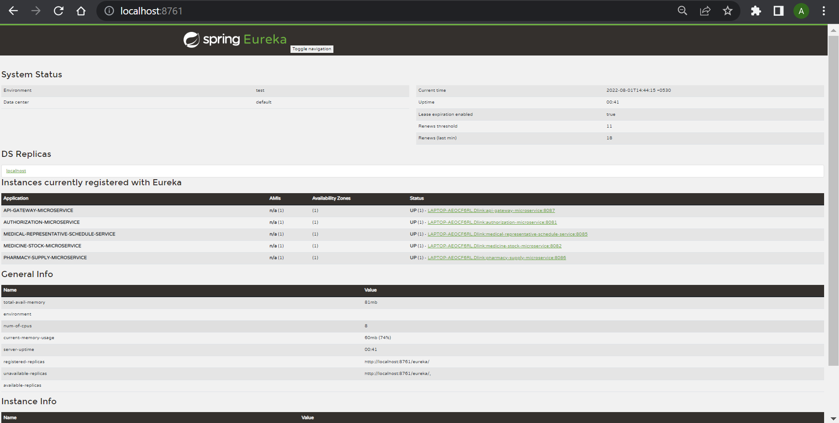

Slide 32

Cloud Deployment

Slide 33
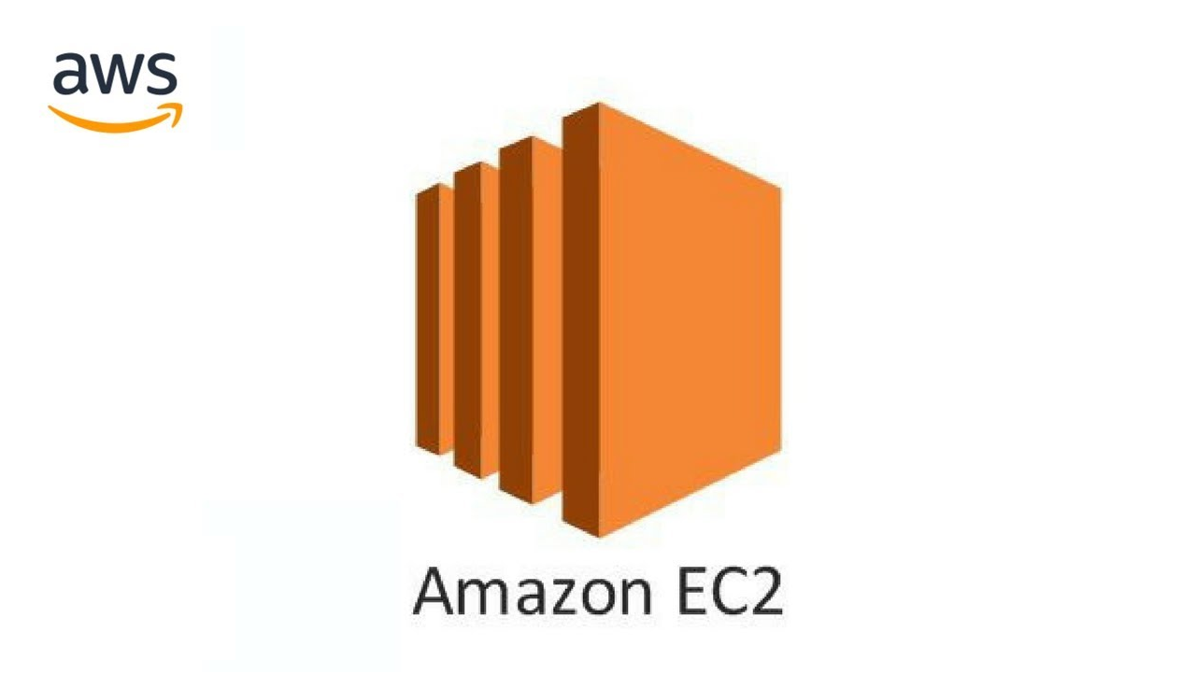






AWS Core Services

Slide 34
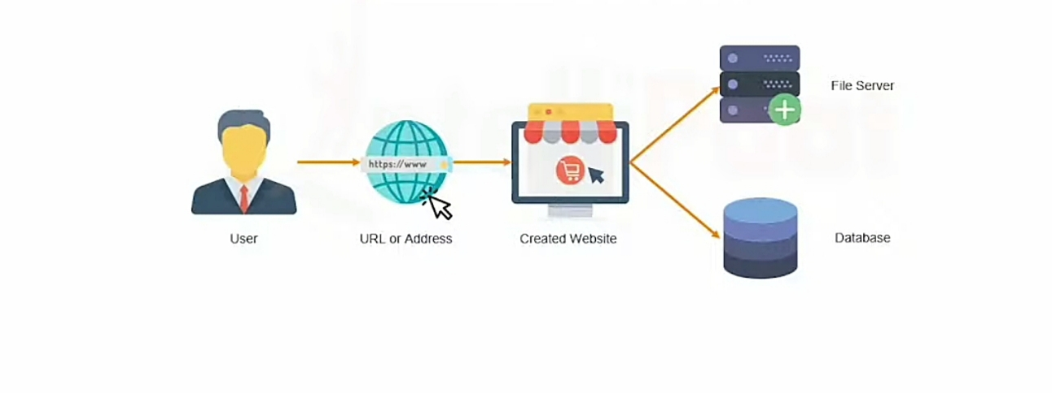
Use Case Architecture

Slide 35
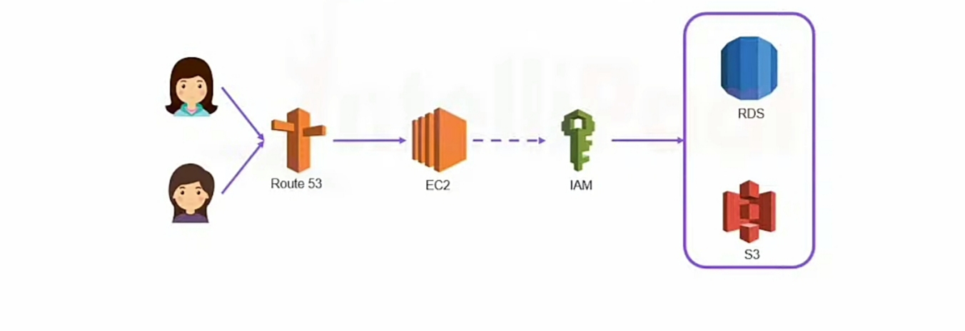
Use Case Migration To AWS

Slide 36
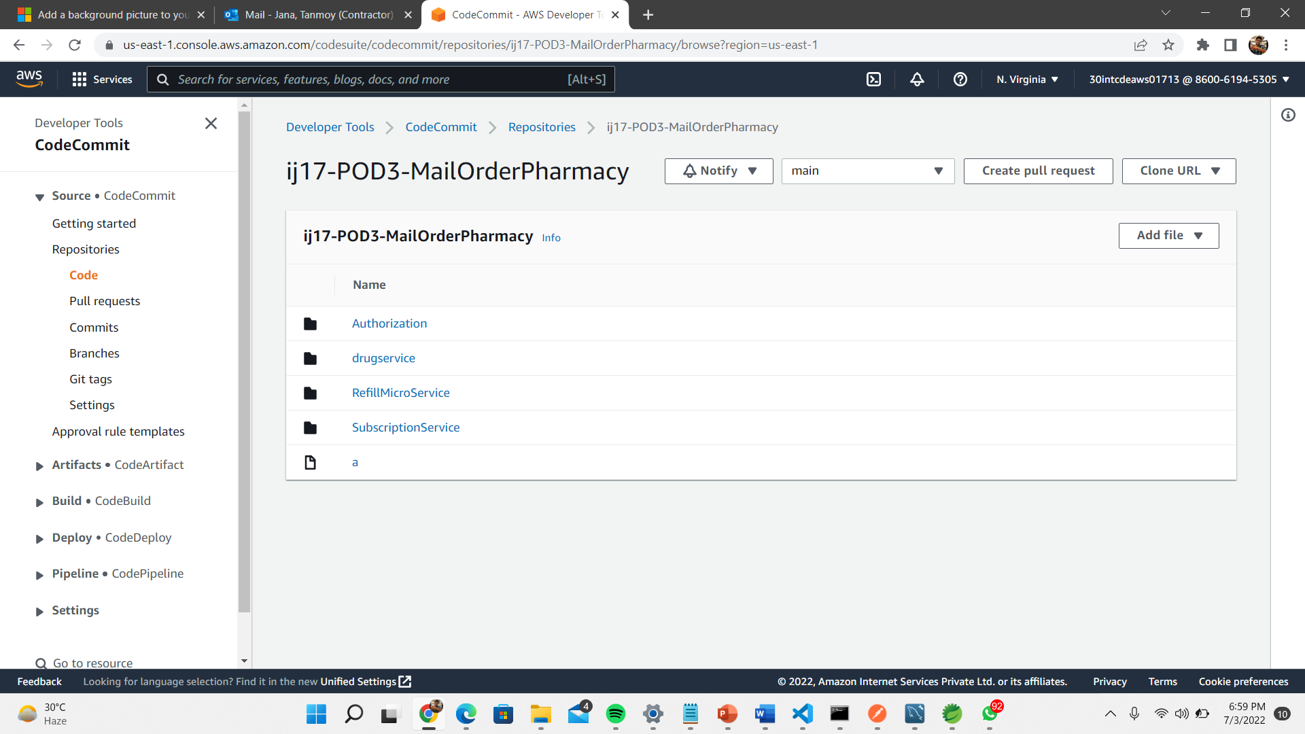
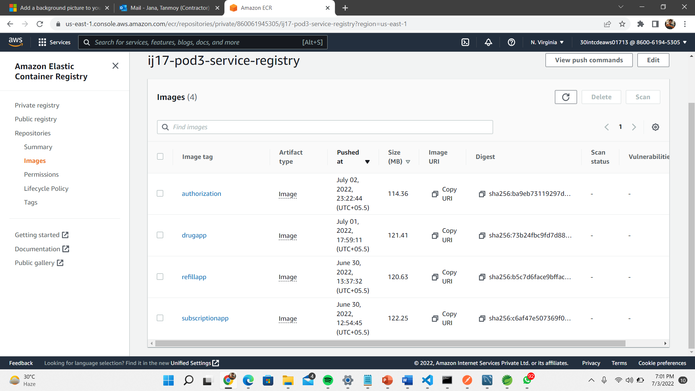
Code Commit
ECR

Slide 37
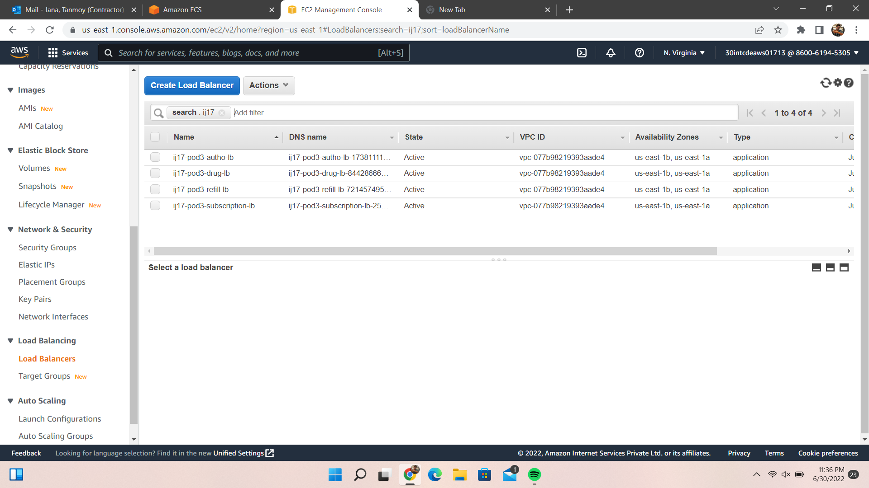
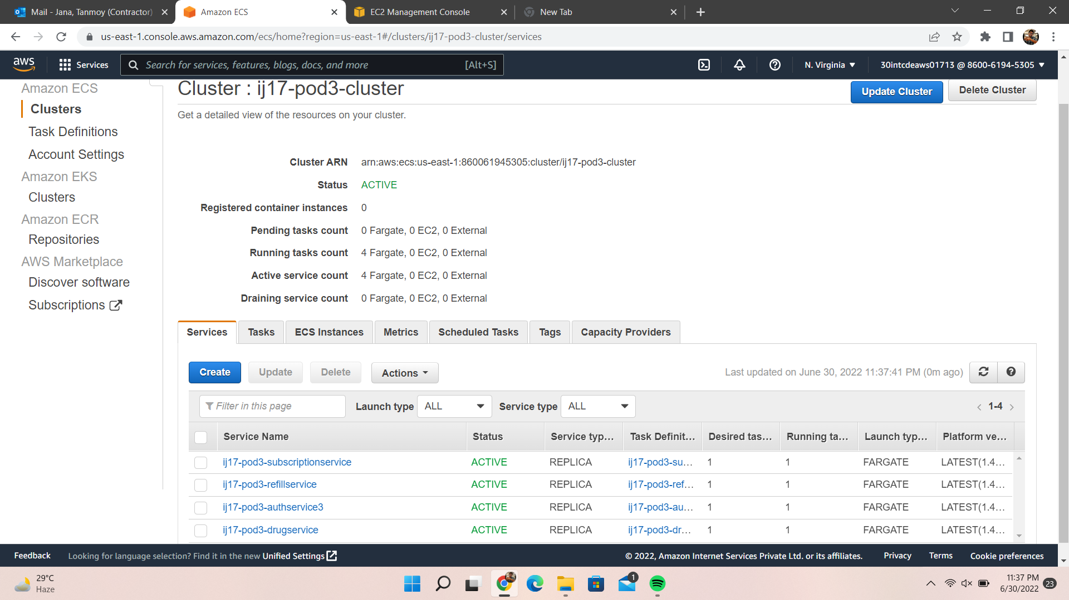
Load Balancer
ECS

Slide 38
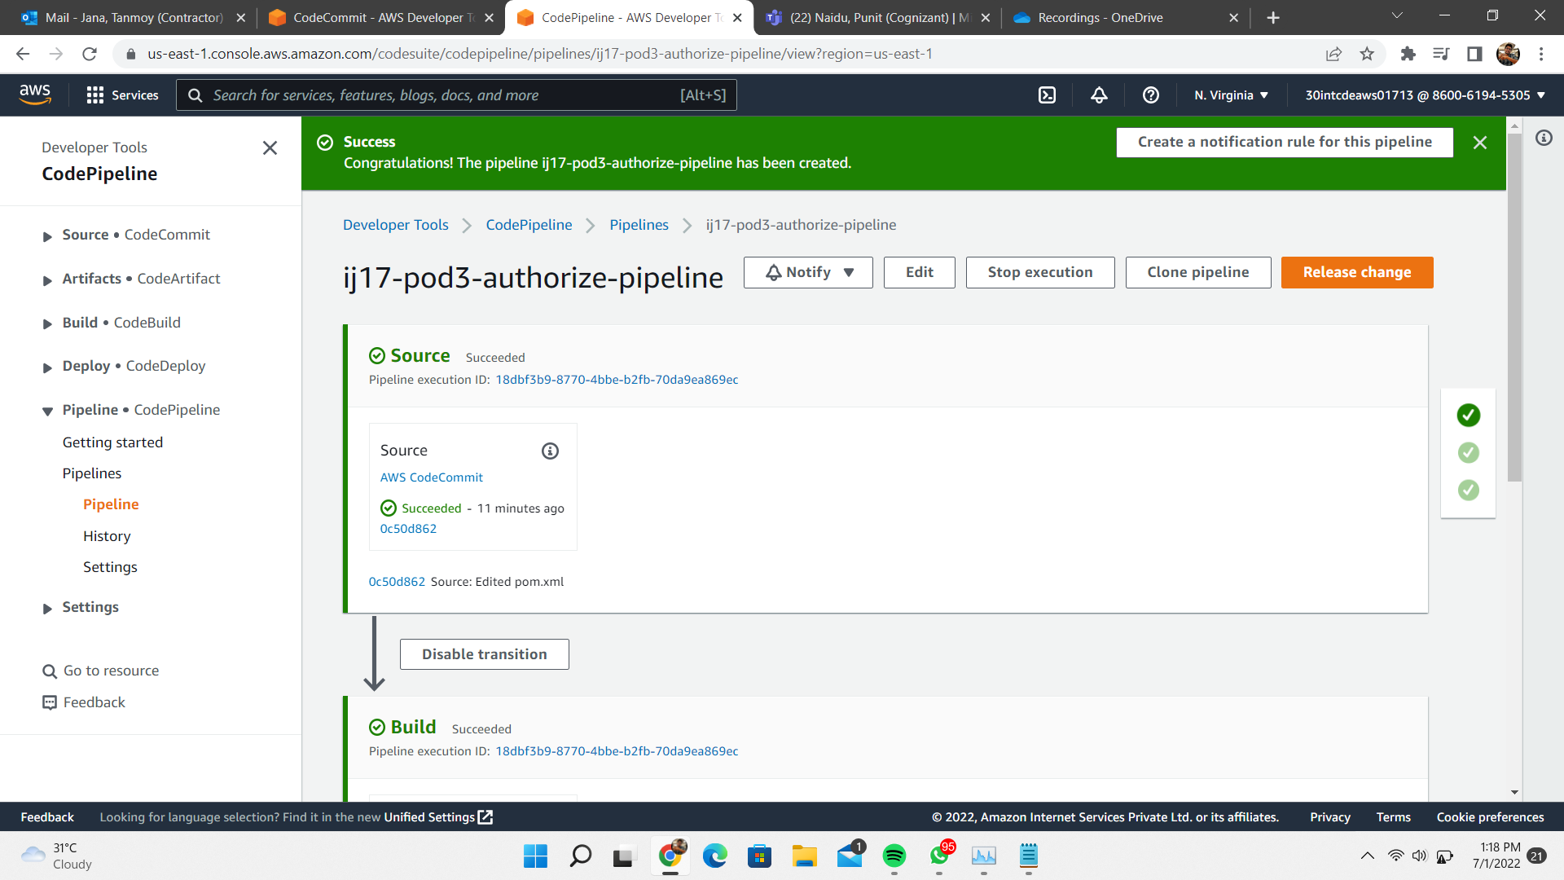
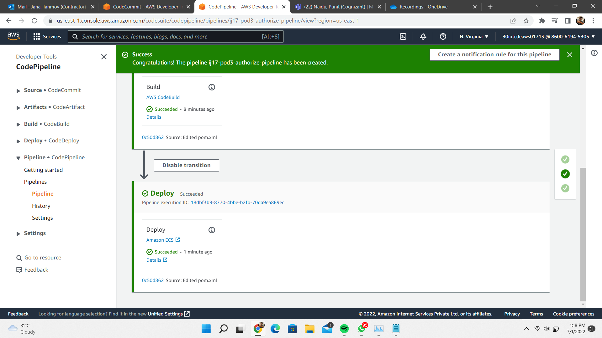
Code Pipeline

Slide 39
Front End
Angular

Slide 40
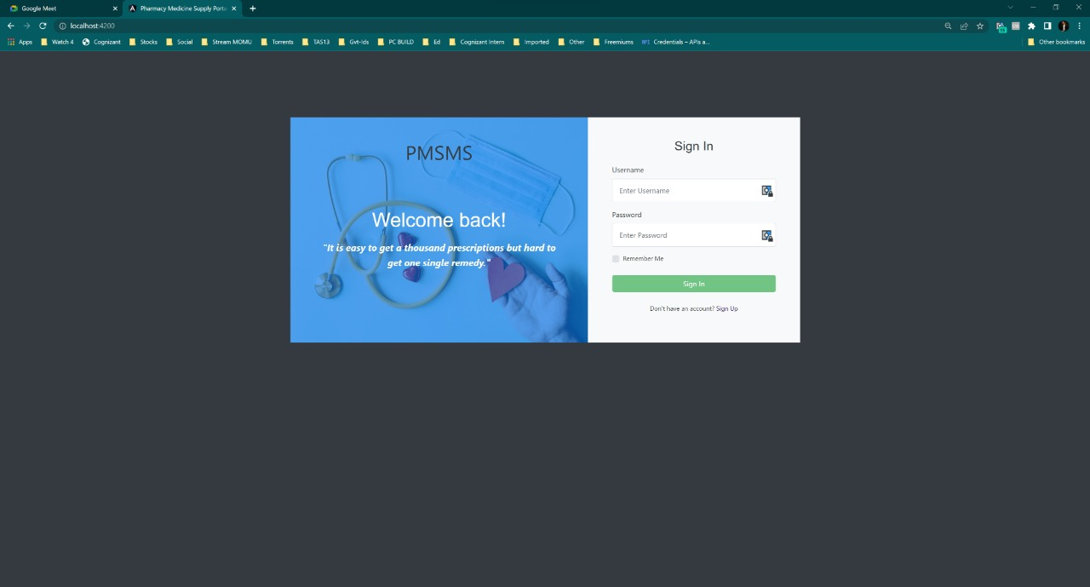
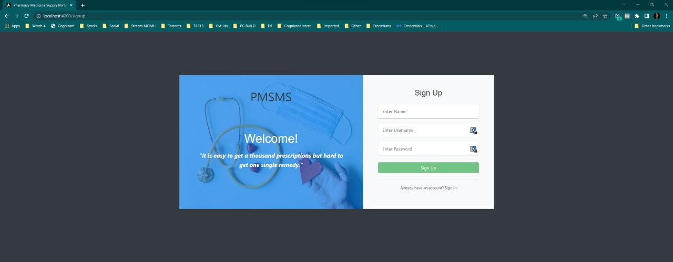
SIGN-IN PAGE
SIGN-UP PAGE

Slide 41
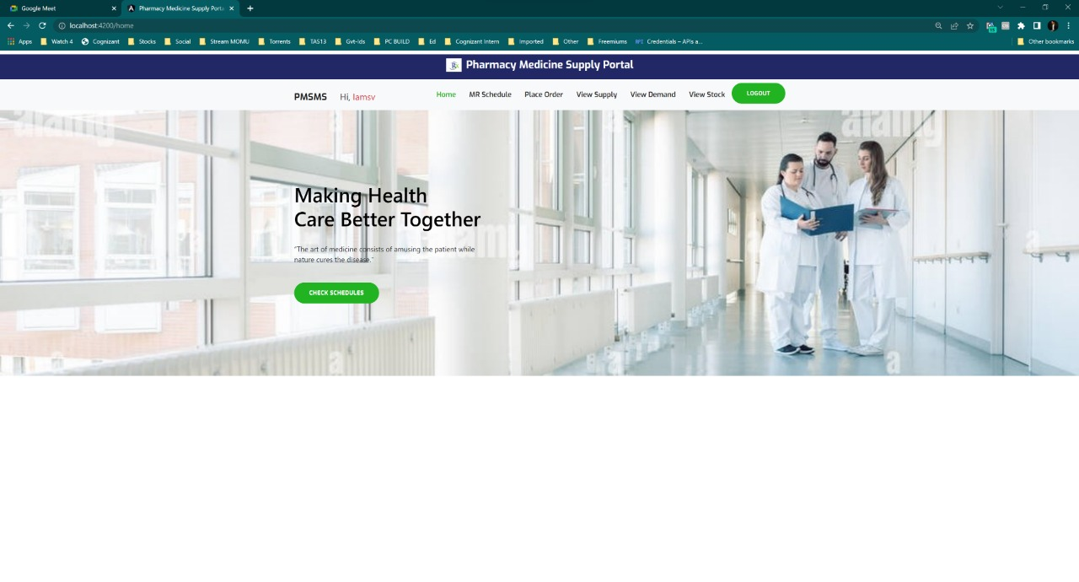
HOME PAGE

Slide 42
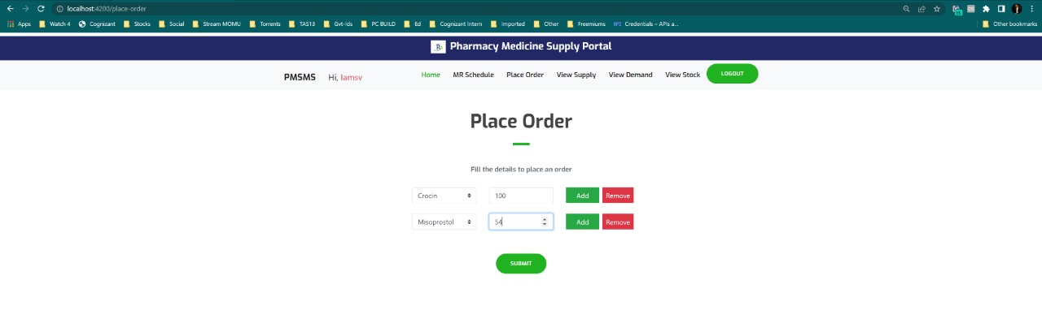
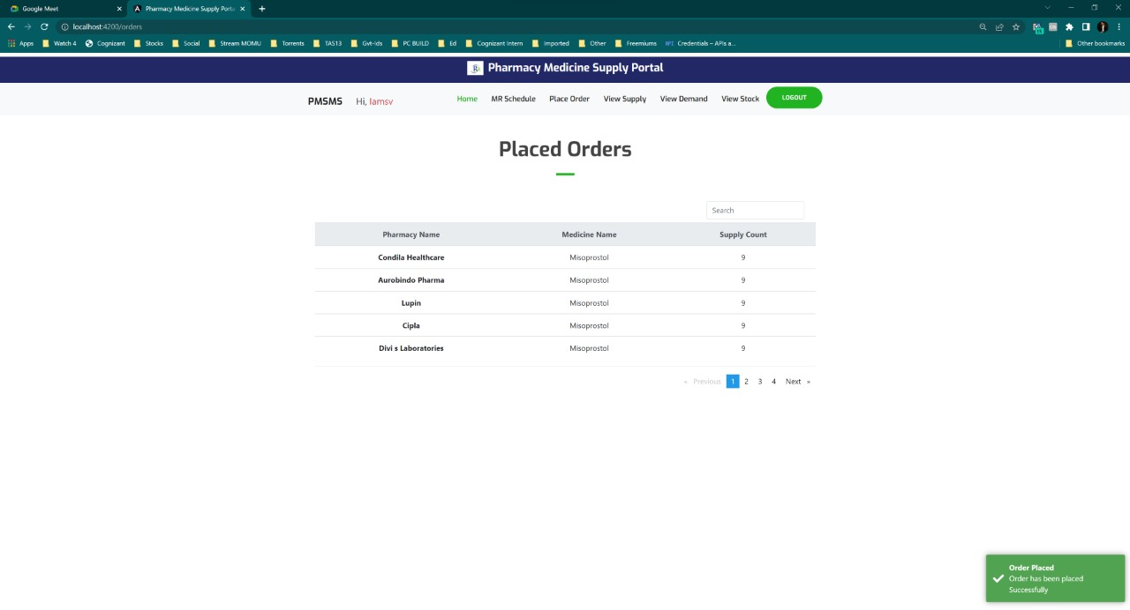
PLACING ORDER
ORDERS

Slide 43
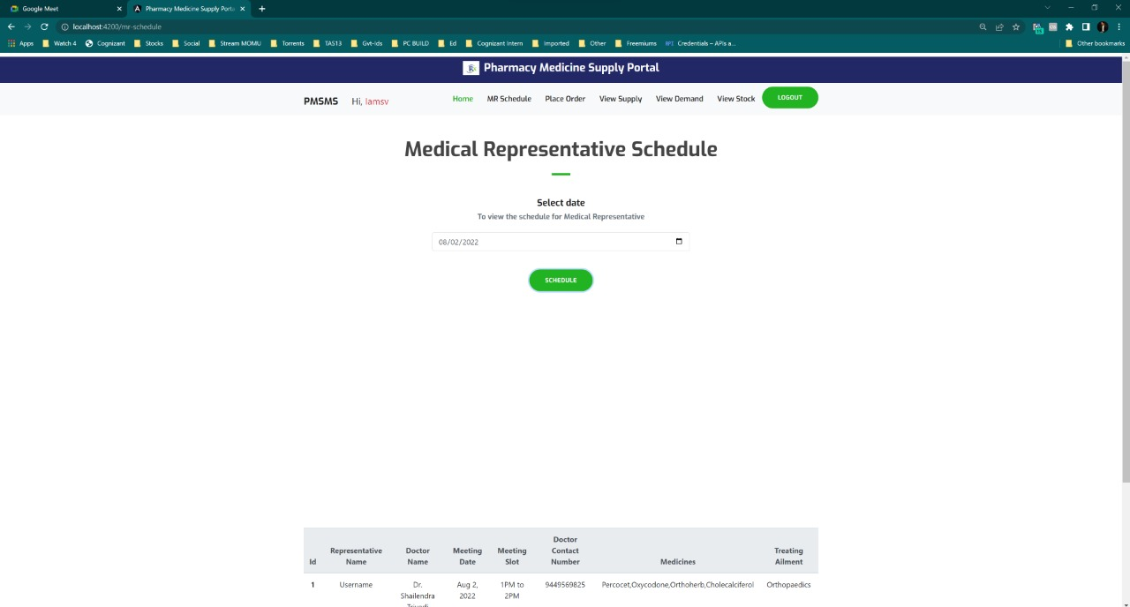
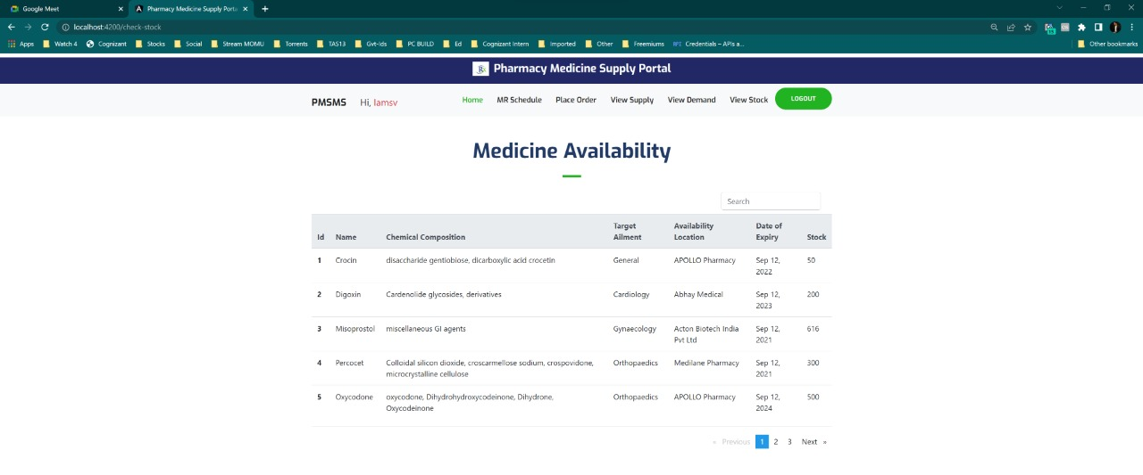
MR SCHEDULE
MEDICINE AVAILABILITY

Slide 44
Acknowledgement
This project, entitled “Pharmacy Medicine Supply Management System” would not be successful without the sincere cooperation and guidance of our Mentor K, Manikandan Trainer Krishna Kumar Maddela, Venkata,
Coach R, Prema whose insightful comments, useful resources and motivation throughout various phases of this project proved to be crucial for the completion of this documentation and also we want to thank Cognizant for giving us this opportunity.

Slide 45
Thank You!

